Slide 1
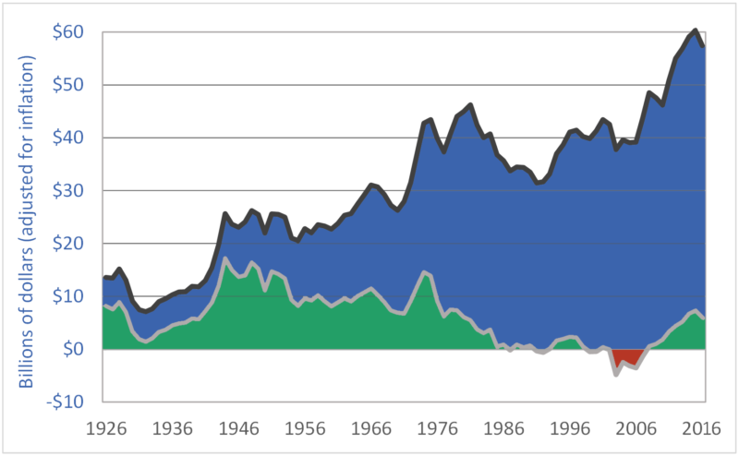
Canadian Gross Farm Income and Net Revenue, 1926-2016
Gross Income
Net Revenue
Source: Darrinqualmin.com, Statistics Canada

